Slide 1
Jobs and Ambitions
Basic 4 – Unit 12 Lesson A

Slide 2
http://www.youtube.com/watch?v=xW_sQgeSdmg
Basic 4 – Unit 12 Lesson A

Slide 3
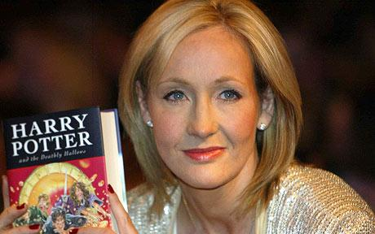
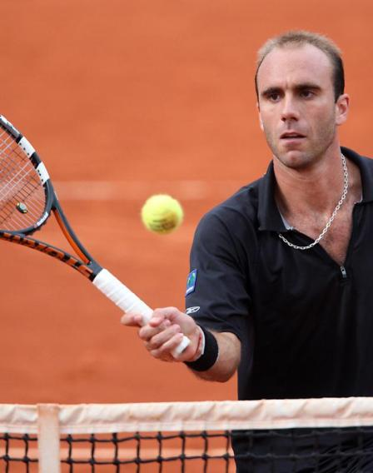
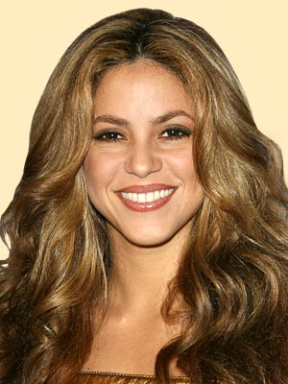
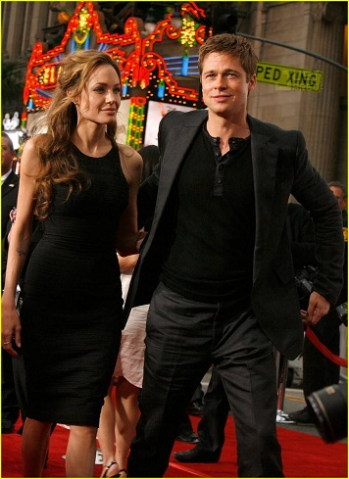
What do they do?
Athlete
Writer
Singer
Actress
Actor

Slide 4
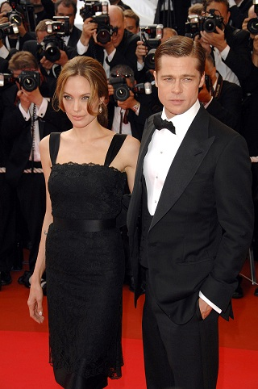
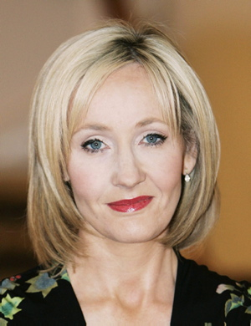
What do they do?
Shakira is a singer.
Luis Horna is an athlete.
J.K. Rowlings is a writer.
Angelina Jolie is an actress.
Brad Pitt is an actor.

Slide 5
What do they do?

Slide 6
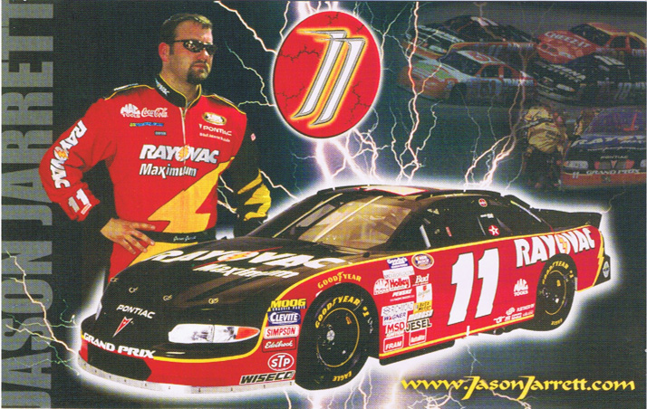
Race-car driver

Slide 7
Doctor

Slide 8
Nurse

Slide 9
Waiter

Slide 10
Waitress

Slide 11
Dentist

Slide 12
Veterinarian (Vet)

Slide 13
Cook

Slide 14
Teacher

Slide 15
Policeman

Slide 16
Engineer

Slide 17
Secretary

Slide 18
Driver

Slide 19
Hairdresser

Slide 20
Student

Slide 21
Carpenter

Slide 22
Plumber

Slide 23
Dancer

Slide 24
Farmer

